Slide 1

AI APPROACH TO DETECT BLOOD TYPE FROM FINGERPRINT
Batch - 11
KARPAGAM INSTITUTE OF TECHNOLOGY
Presented by
ANBUSELVAM V (721220205002)
INDHUMATHI M(721220205014)
KARUPPASAMY B (721220205024)
NARRENDRAN P (721220205034)
Guided by
Ms. GOKILA S M.E.,
ASSISTANT PROFESSOR,
DEPARTMENT OF INFORMATION TECHNOLOGY,
KARPAGAM INSTITUTE OF TECHNOLOGY,COIMBATORE.

Slide 2
ABSTRACT
An approach utilizing fingerprint images for non-invasive blood group prediction employing the VGG-19 model.
By using fingerprint images, the system streamlines the blood group identification process, potentially reducing healthcare costs and enhancing patient comfort.
The system provides a user-friendly interface for capturing or uploading fingerprint images, processing them through the model, and presenting the predicted blood group to users.
1/7

Slide 3
OBJECTIVE
The primary objective of this research is to develop a reliable and efficient system capable of predicting blood groups accurately from fingerprint images, thus eliminating the need for invasive blood tests.
The utilization of fingerprint images offers several advantages, including high precision ,non-invasiveness, ease of acquisition, and potential for rapid and automated analysis.
2/7

Slide 4
IDENTIFICATION AND ANALYSIS OF PROBLEM
In the medical domain, accurate and efficient blood group identification is crucial for various clinical procedures, transfusions, and emergencies.
Traditional methods often involve invasive blood tests, which can be time-consuming and uncomfortable for patients.
Blood group identification is a fundamental aspect of medical diagnostics, essential for various clinical procedures such as blood transfusions, organ transplants, and prenatal care. Traditional methods of determining blood types often involve invasive procedures, requiring blood samples and laboratory analysis.
3/7

Slide 5
EXISTING SYSTEM(Literature Survey)
REFERENCE JOURNAL | DRAWBACKS
Fingerprint Based Blood Group Prediction Using Deep Learning (2024) | Datasets need to be expanded with more fingerprint samples and corresponding blood group data. Needed to consider additional fingerprint features.
The association between fingerprint patterns and blood groups in the Omani population(2022) | The sample size was small and study was restricted to few regions of Oman , findings cannot be generalized outside the environment.
4/7

Slide 6
REFERENCE JOURNAL | DRAWBACKS
Blood group determination using fingerprint (2024) | Using preconfigured architectures like AlexNet and LeNet-5 for fingerprint classification in association with blood groups is that these architectures may not be optimized for the specific features and patterns present in fingerprints relevant to blood group classification
A Novel Approach to Predict Blood Group using Fingerprint Map Reading (2021) | One drawback of this proposed technique for blood group identification using fingerprint biometrics is its current accuracy level of 62%0
4/7

Slide 7
REFERENCE JOURNAL | DRAWBACKS
Blood Group Detection through Finger Print Images using Image Processing(2023) | Drawback of using image processing and neural networks for blood group recognition is the potential for errors in classification.
4/7

Slide 8
PROPOSED SYSTEM
The proposed approach offers several advantages, including non-invasiveness, rapidity, and scalability using VGG-19 model.
Enhances prediction accuracy and robustness, making it suitable for real-world applications in clinical settings.
The proposed system demonstrates promising results, paving the way for advancements in non-invasive blood group identification techniques with implications for various medical applications and healthcare practices.
4/7

Slide 9
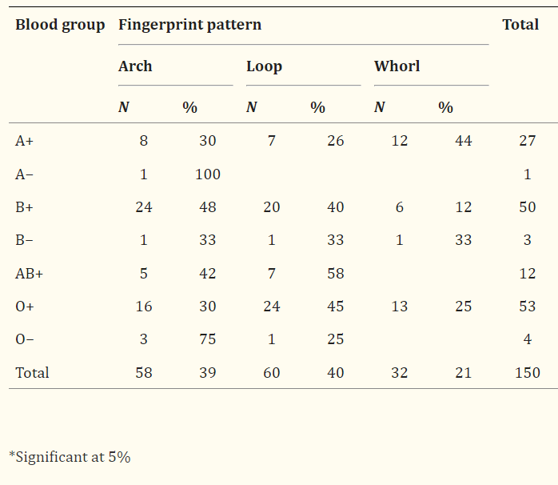
Distribution of fingertip pattern of hand
according to blood group
4/7

Slide 10
PROJECT DOMAIN AND TECHNOLOGICAL STACKS
Domain –Mobile Application
Framework - Flask
Front end - HTML
Back end – Python
Version ctrl - Git
Datasets for pre-training
4/7

Slide 11
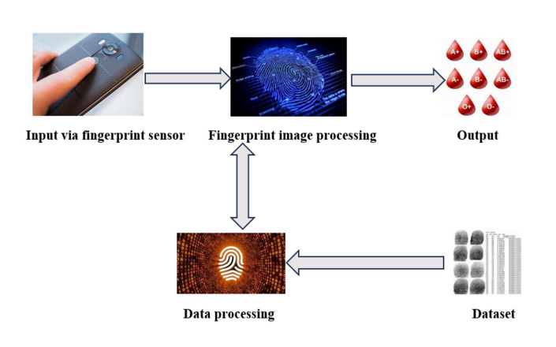
SYSTEM ARCHITECTURE
4/7

Slide 12
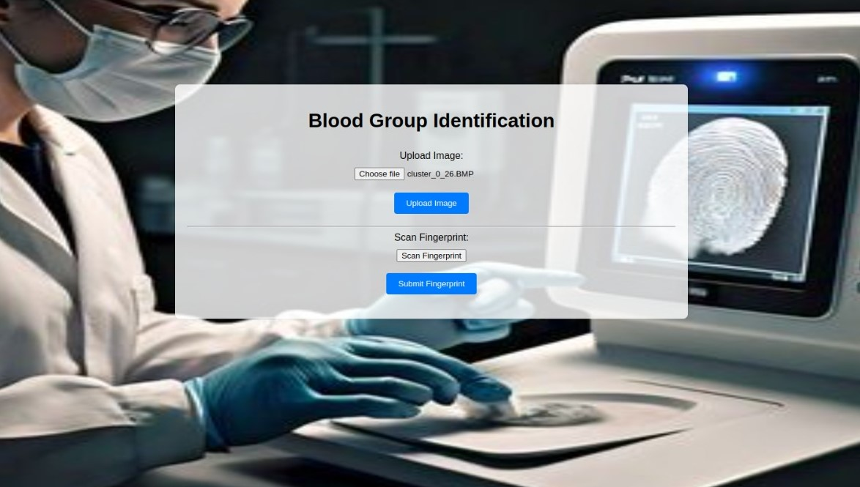
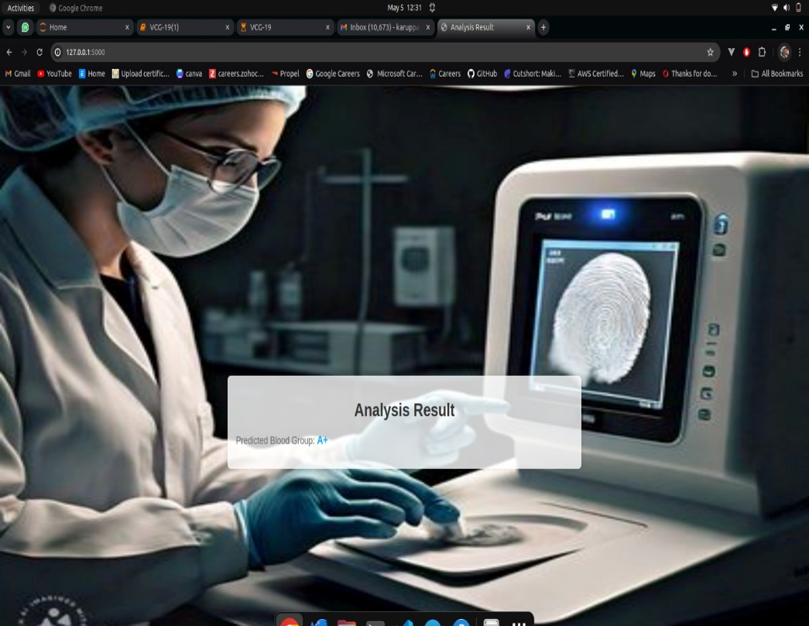
RESULT AND ANALYSIS
Home page
A+
4/7

Slide 13


A-
AB+

Slide 14


O+
B+

Slide 15
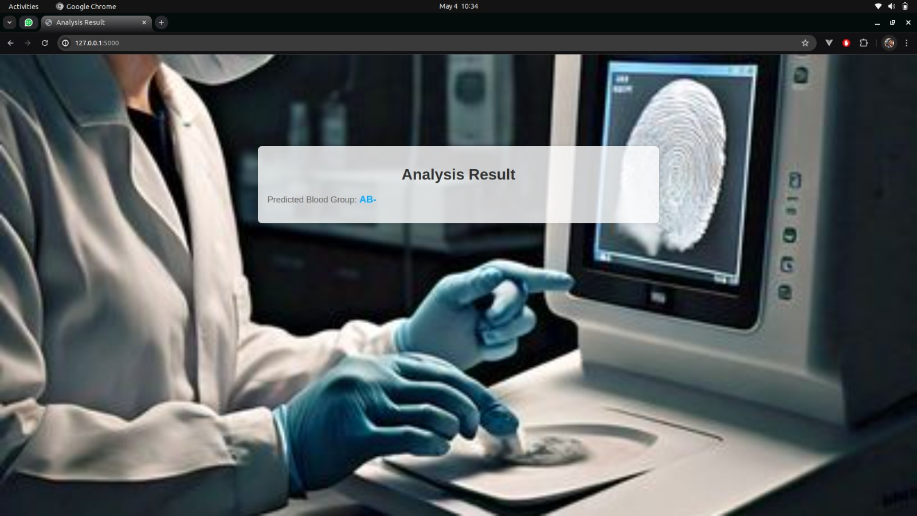
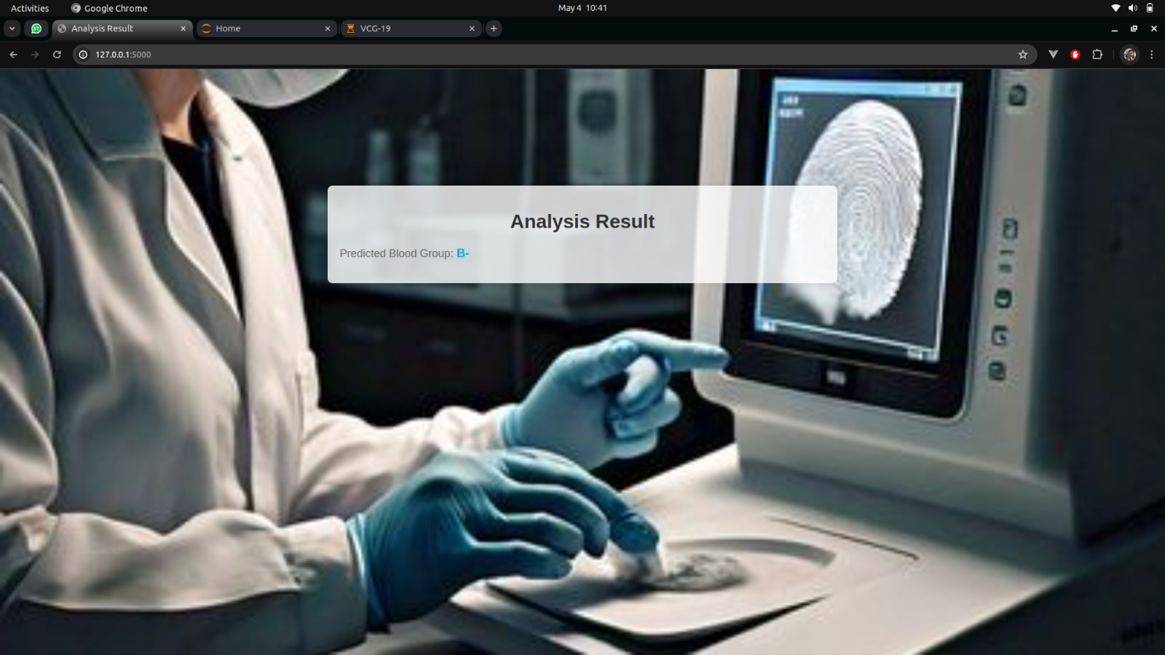
AB-
B-

Slide 16
FUTURE ENHANCEMENT
The model can be extended to predict Rh factor and antibody presence.
A user-friendly mobile application can be developed.
The application with enhanced accuracy and robustness can be developed.
4/7

Slide 17
GitHub
https://github.com/Anbuselvam9600/Blood_Dectection-\
4/7

Slide 18
REFERENCE
Fingerprint Based Blood Group Prediction Using Deep Learning (2024)
https://ijarsct.co.in/A15393.pdf
The association between fingerprint patterns and blood groups in the Omani population(2022)
https://www.emerald.com/insight/content/doi/10.1108/AGJSR-10-2022- 0223/full/pdf?title=the-association-between-fingerprint-patterns-and-
blood-groups-in-the-omani-population
A Novel Approach to Predict Blood Group using Fingerprint Map Reading(2021)
https://ieeexplore.ieee.org/abstract/document/9418114/
4/7

Slide 19
REFERENCE
Blood Group Detection through Finger Print Images using Image Processing
https://www.ijraset.com/best-journal/blood-group-detection-through
finger-print-images-using-image-processing
Blood group determination using fingerprint
https://www.matec-
conferences.org/articles/matecconf/pdf/2024/04/matecconf_icmed2024_0
1069.pdf
4/7

Slide 20
CONCLUSION
This approach contributes to advancements in non-invasive medical diagnostics, with implications for improved patient care and healthcare efficiency.
Enhances the system's accuracy and efficacy in real-world clinical settings.
4/7

Slide 21
Q and A?
?

